Slide 1
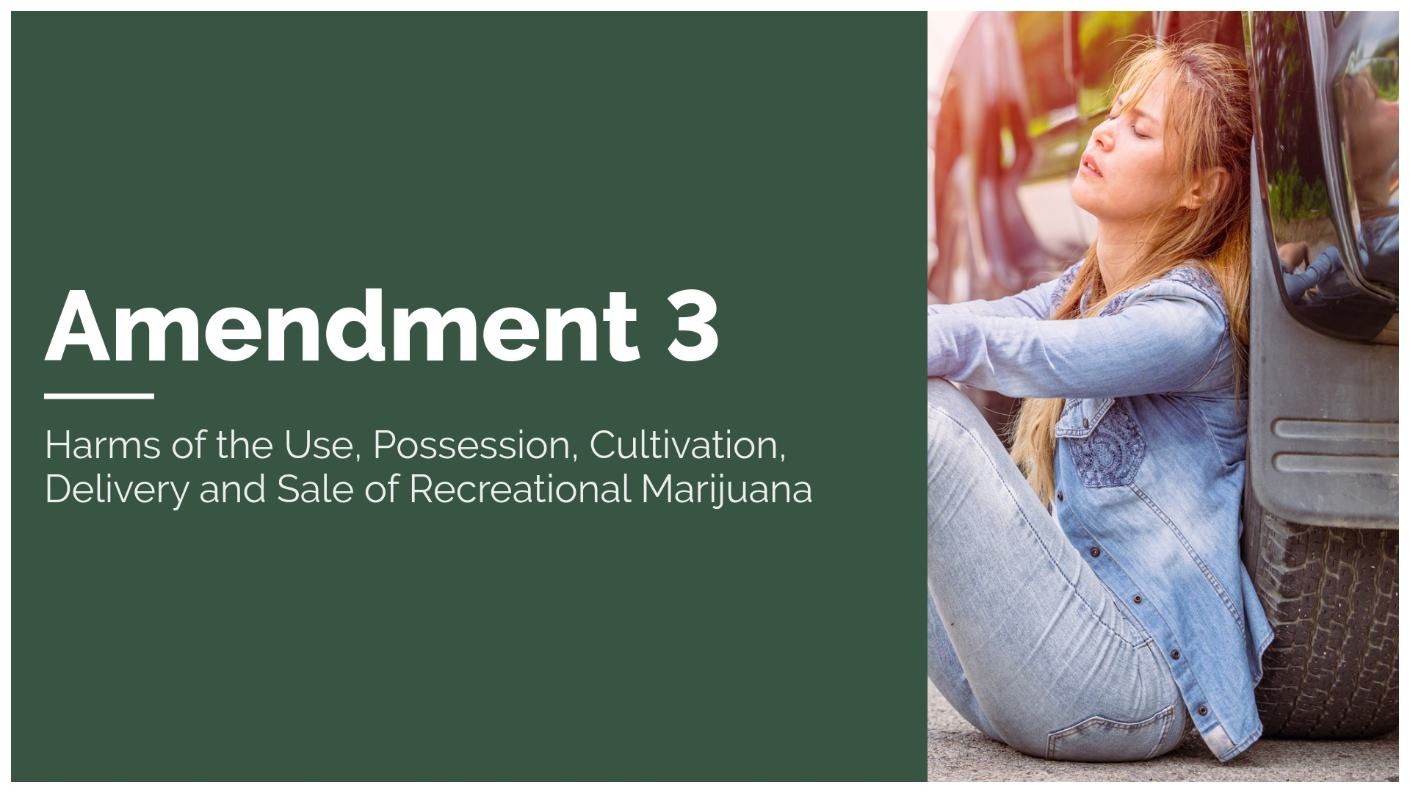

Slide 2
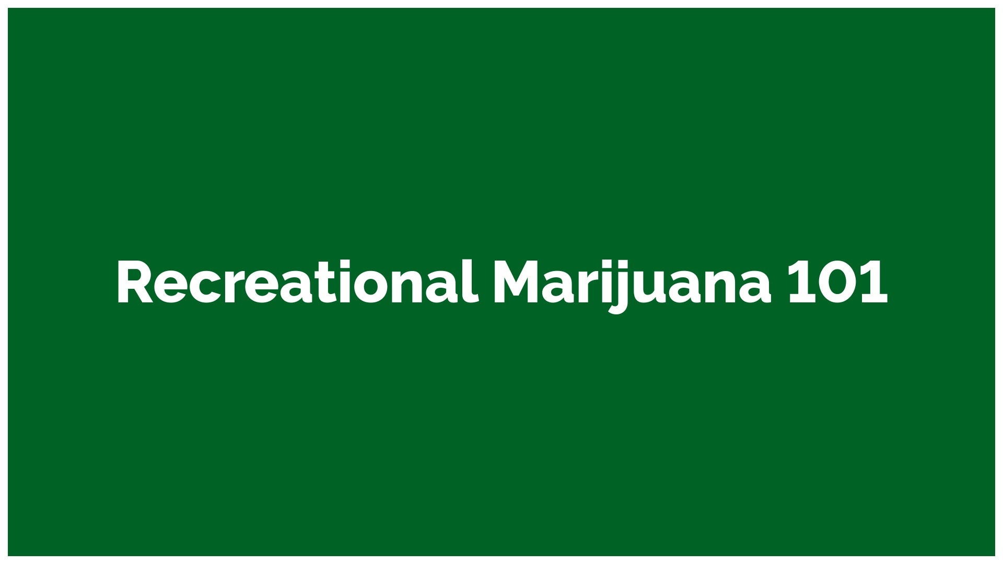

Slide 3
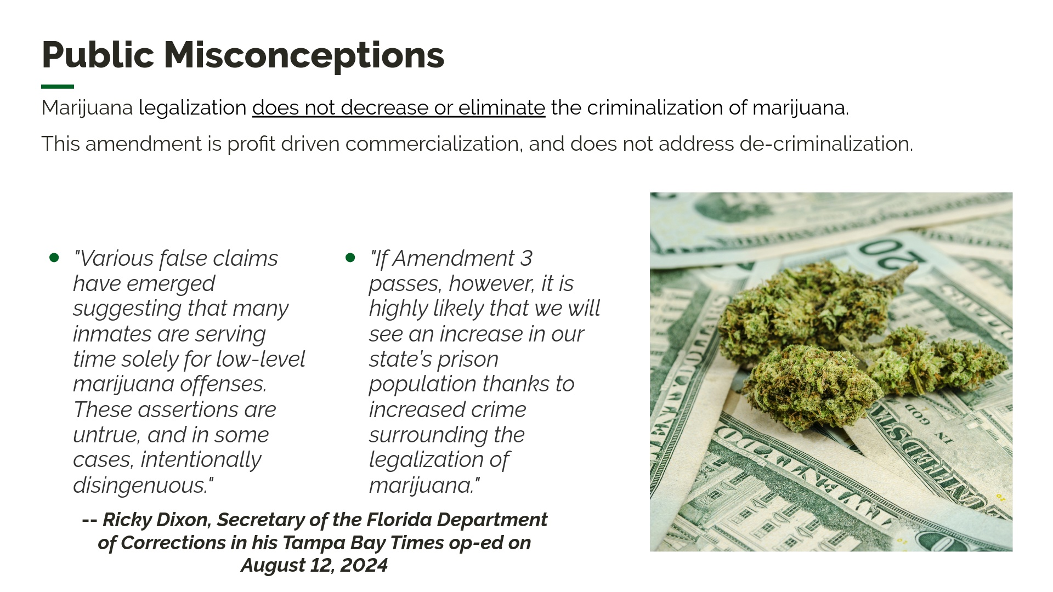
Notes:
Since 2012 several states have pursued the legalization and commercialization of marijuana have spurred the growth of a profit-driven marijuana industry that has pursued its profits ahead of public health.between 2012 and 2022, the number of past-year marijuana users nearly doubled from 31.5 million to 61.9 million

Slide 4
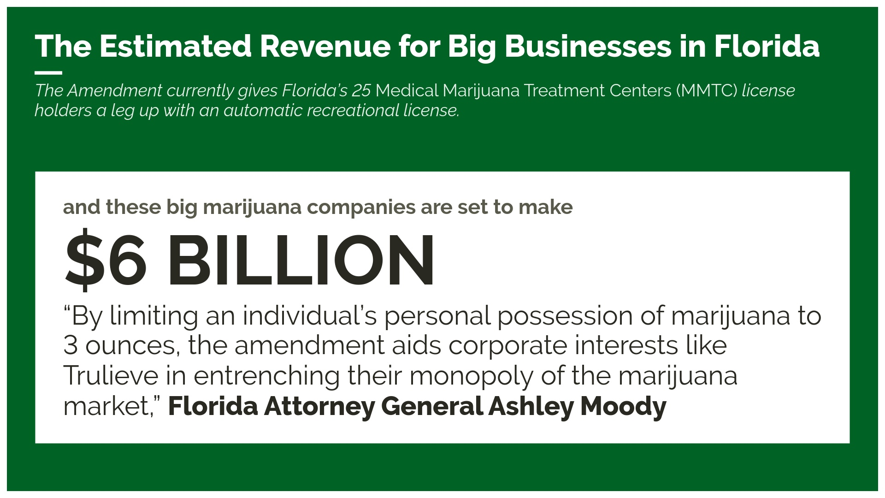
Notes:
Amendment 3 would establish a monopoly for large, mostly out-of-state corporations to dominate what could be a $6 billion industry in Florida. Unlike other states where small-business owners are supported and competition is encouraged, Amendment 3 funnels all sales through a few existing dispensaries. This not only stifles competition but ensures that only corporations profit, rather than benefiting local growers or smaller businesses“ The ballot summary does not clearly convey to the voters that the amendment would, in this respect, reinforce the stranglehold MMTCs have on the marijuana market in Florida.”

Slide 5
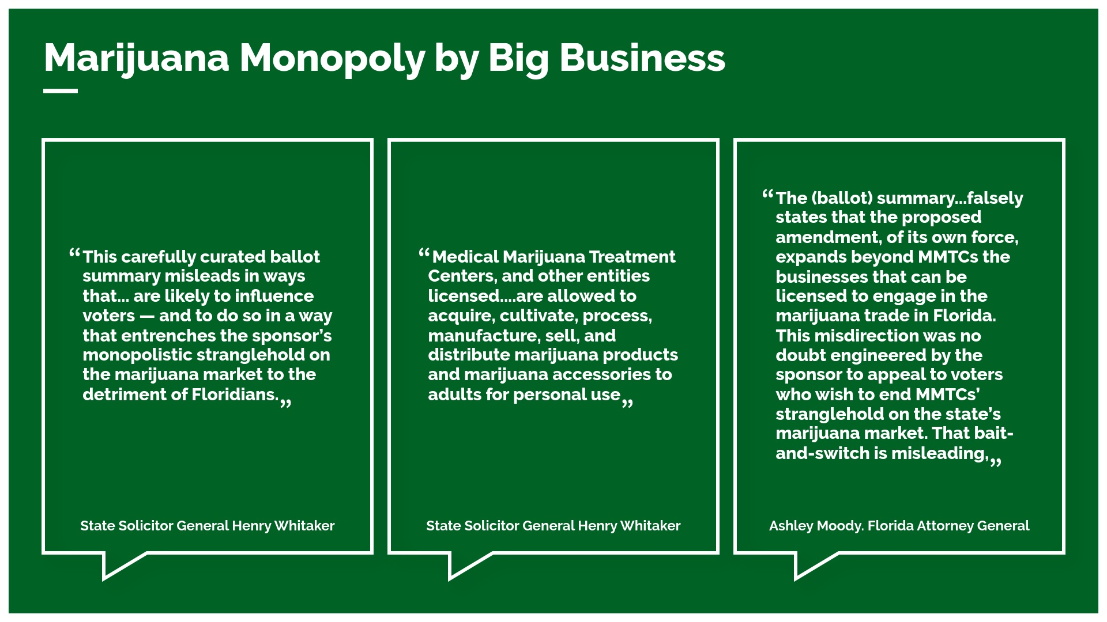
Notes:
The amendment has been designed and heavily funded—over $65 million—by out of state and foreign corporations to secure their control over the market. The purpose of Amendment 3 is NOT to legalize, decriminalize and make marijuana available for adults in Florida, its intent is simply to enrich those that funded and wrote the amendment.

Slide 6
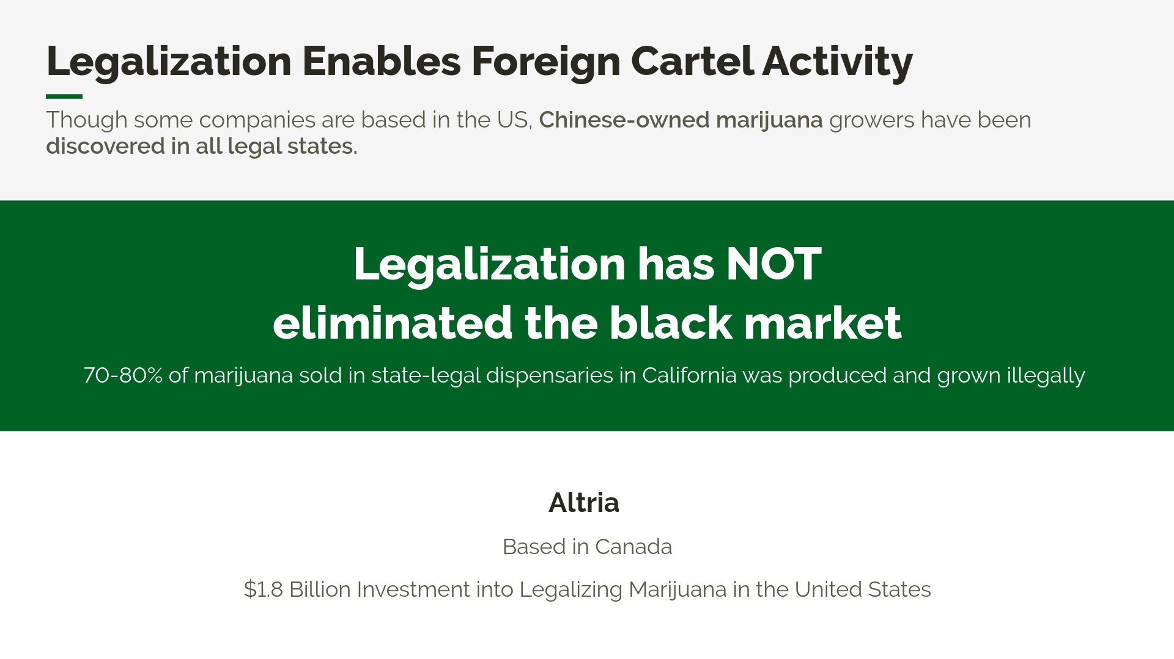
Notes:
China has invested significant resources into purchasing American farmland Chinese nationals and organized crime mostly run these farms in states where marijuana is legal. By using the legal market as cover, illegal operators can hide in plain sight Chinese nationals operate thousands of illegal marijuana farms across the country. Department of Homeland Security (DHS) memo estimates that 749 of the sites are linked to Asian Transnational Criminal Organizations. Some lawmakers and experts say that the CCP is influencing the expansion of illegal grows.In August 2023, a federal memo reported that there are 270 suspected Chinese illegal marijuana grow operations in Maine with an estimated total worth of $4.37 billion, far outpacing the $158 million generated by the state’s legal market last year Most of the properties were purchased after implementation of recreational marijuana sales The Oklahoma Bureau of Narcotics (OBN) estimates that over 2,000 marijuana farms are linked to China According to the OBN, Chinese growers are selling marijuana on the illicit market, laundering money, and sending proceeds back to China

Slide 7
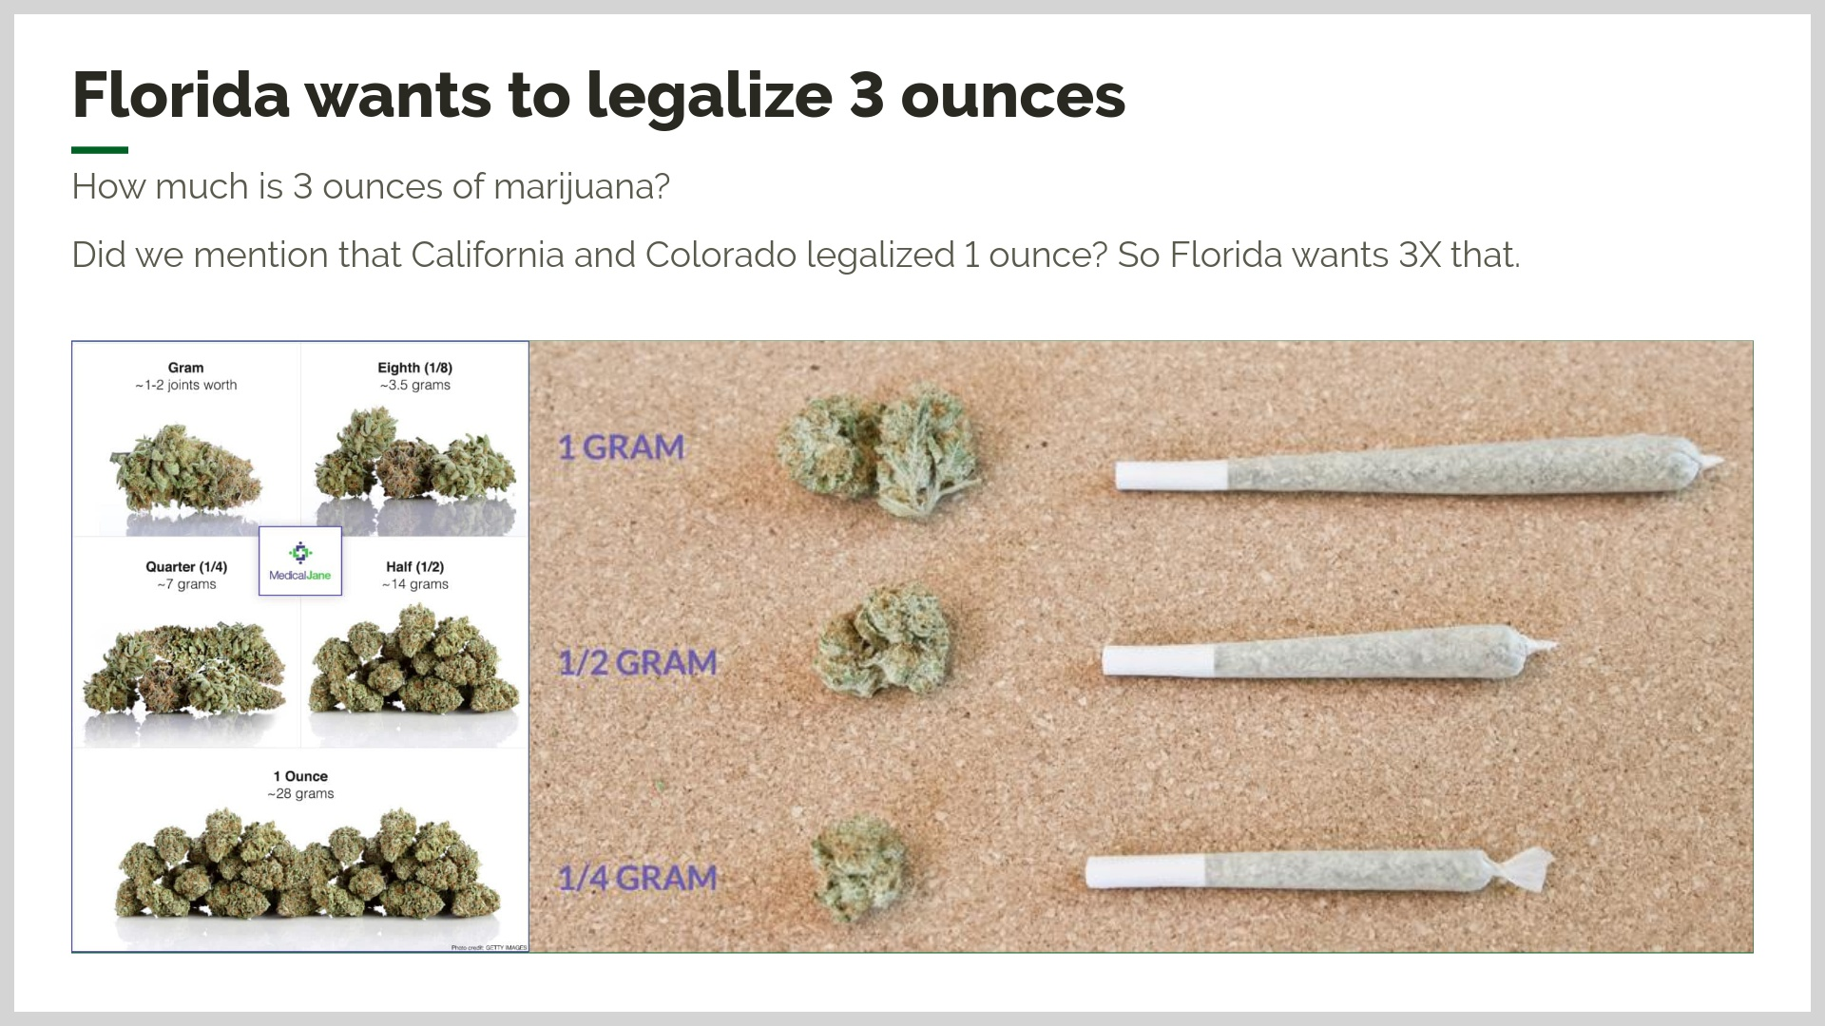
Notes:
Decriminalizes low-level street drug dealing This amendment allows an individual to legally possess 150 marijuana joints - 300% more than California and Colorado - making Florida the state with the largest limit. This extremely large limit would allow street level drug dealers to walk around without fear of being arrested. Nobody needs the ability to carry around 150 joints (3 oz.) for “personal use.” The amendment specifically allows for adults to possess up to 3 ounces of marijuana. (Full Text (13) “Personal Use”...An individual’s possession of marijuana for personal use shall not exceed 3.0 ounces of marijuana…,” Also (4) The non-medical personal use of marijuana products and marijuana accessories by and adult, as defined below, in compliance with this section is not subject to any criminal or civil liability or sanctions under Florida Law.”)

Slide 8
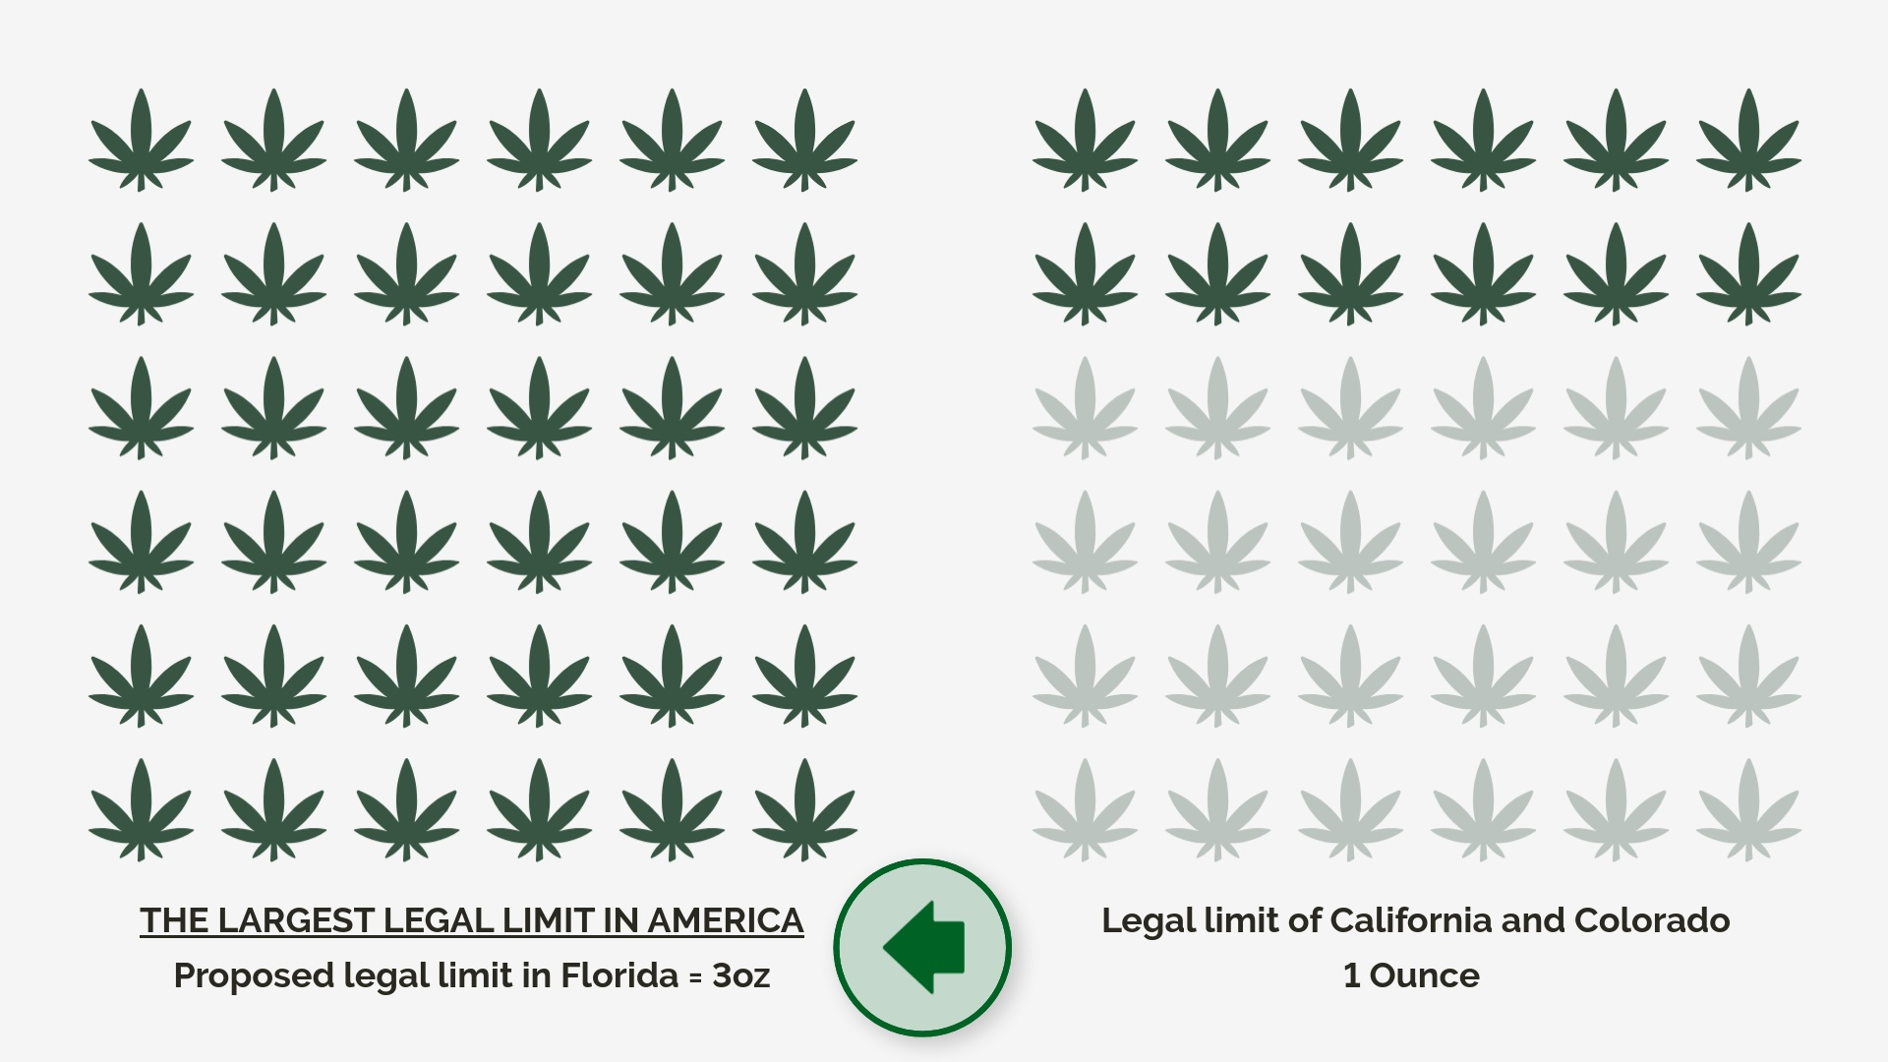

Slide 9
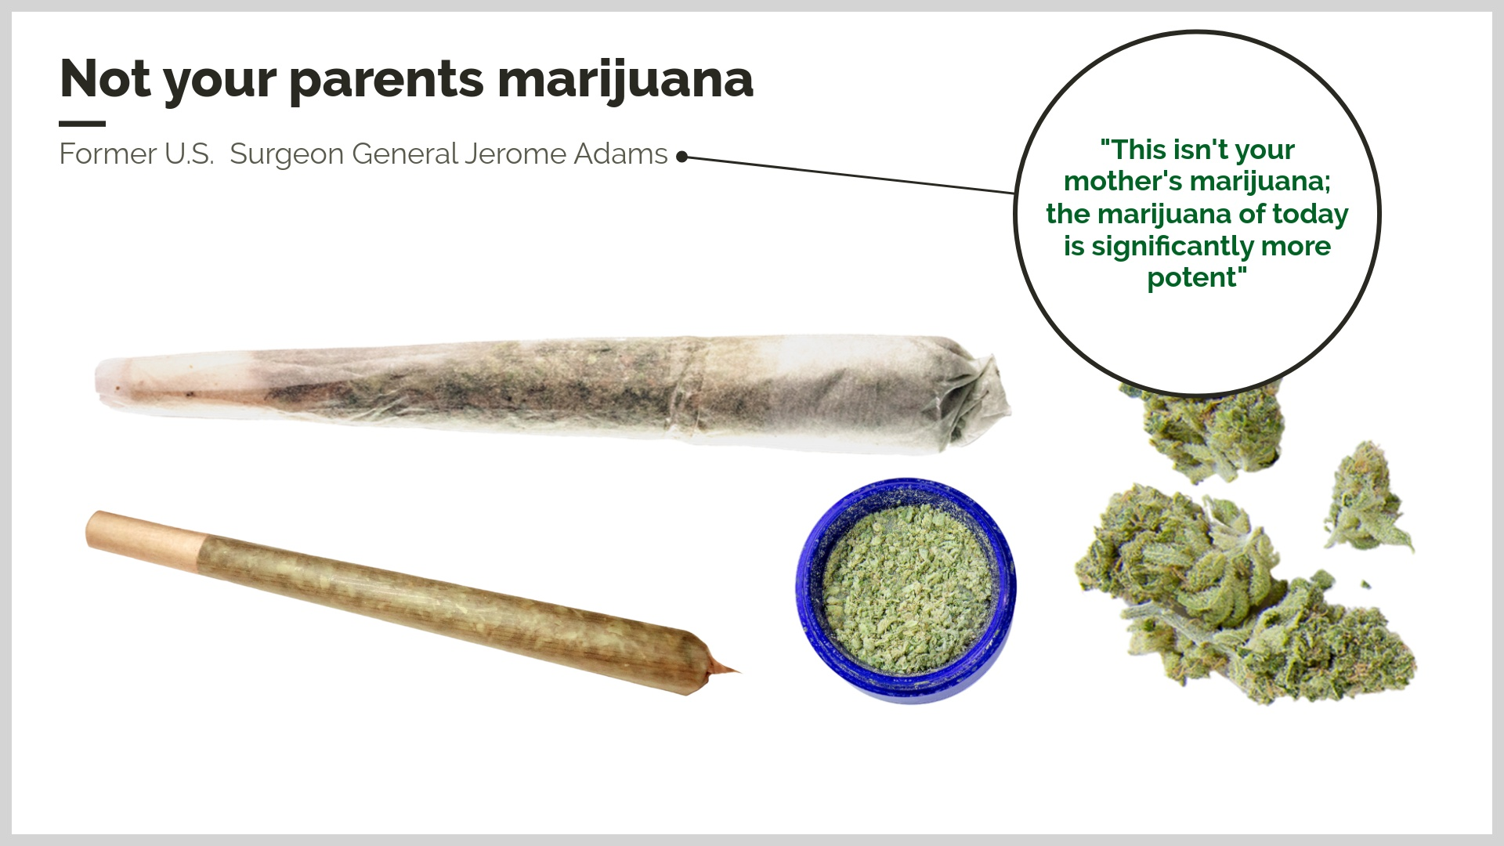

Slide 10
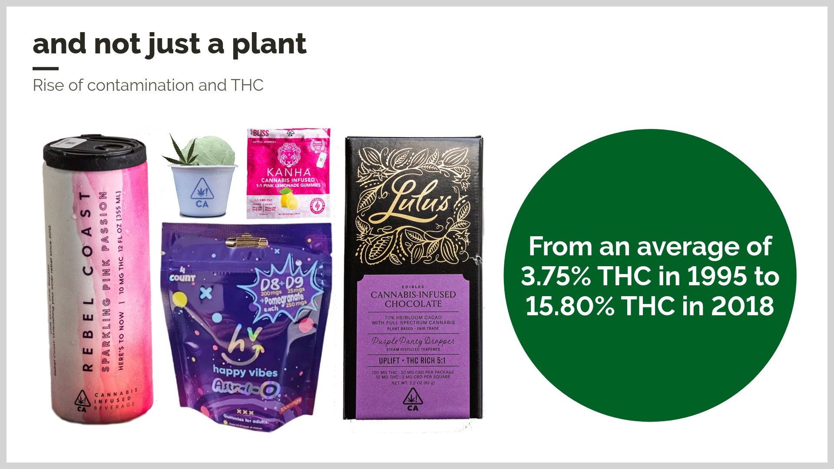

Slide 11
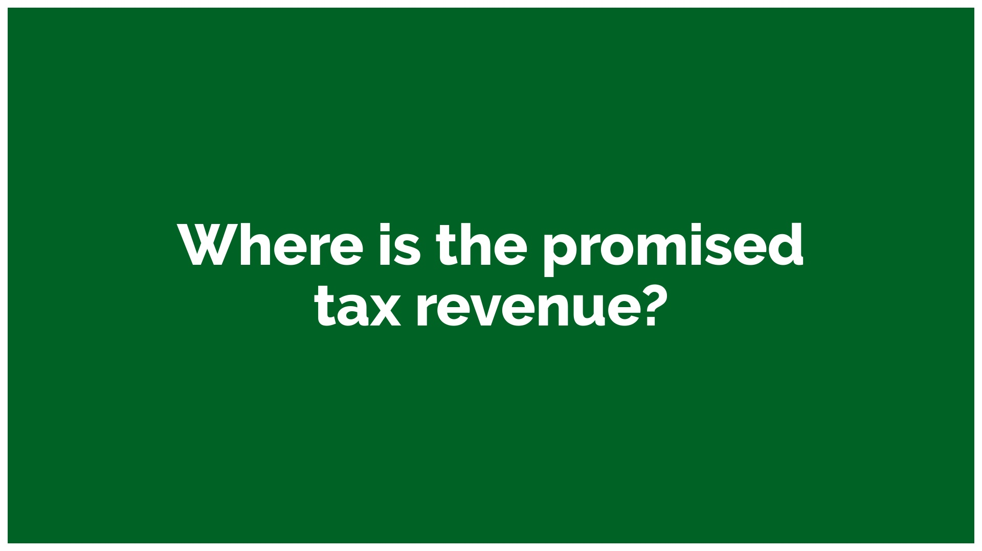

Slide 12
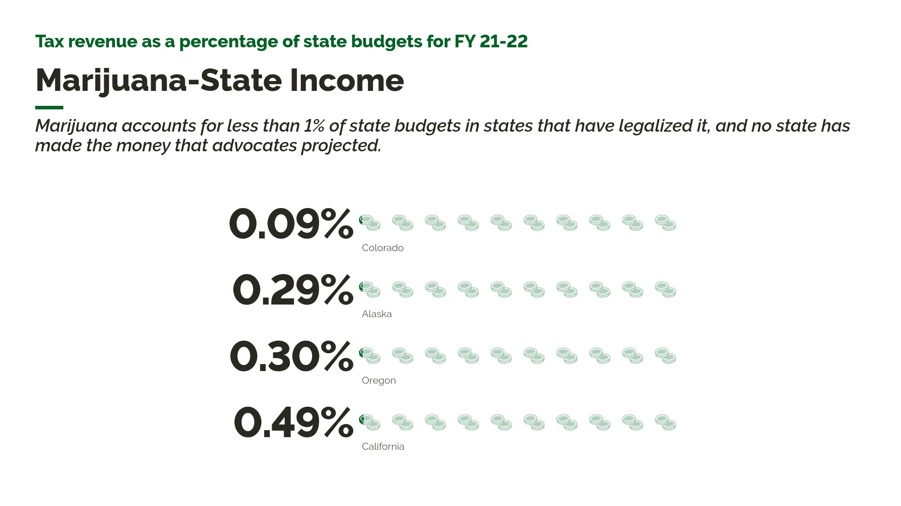
Notes:
advocates of marijuana legalization routinely overestimate the revenue that will be collected and fail to account for the limited marijuana tax revenue collected is offset by even greater costs to taxpayers, ranging from additional healthcare costs to more students dropping out of high school

Slide 13
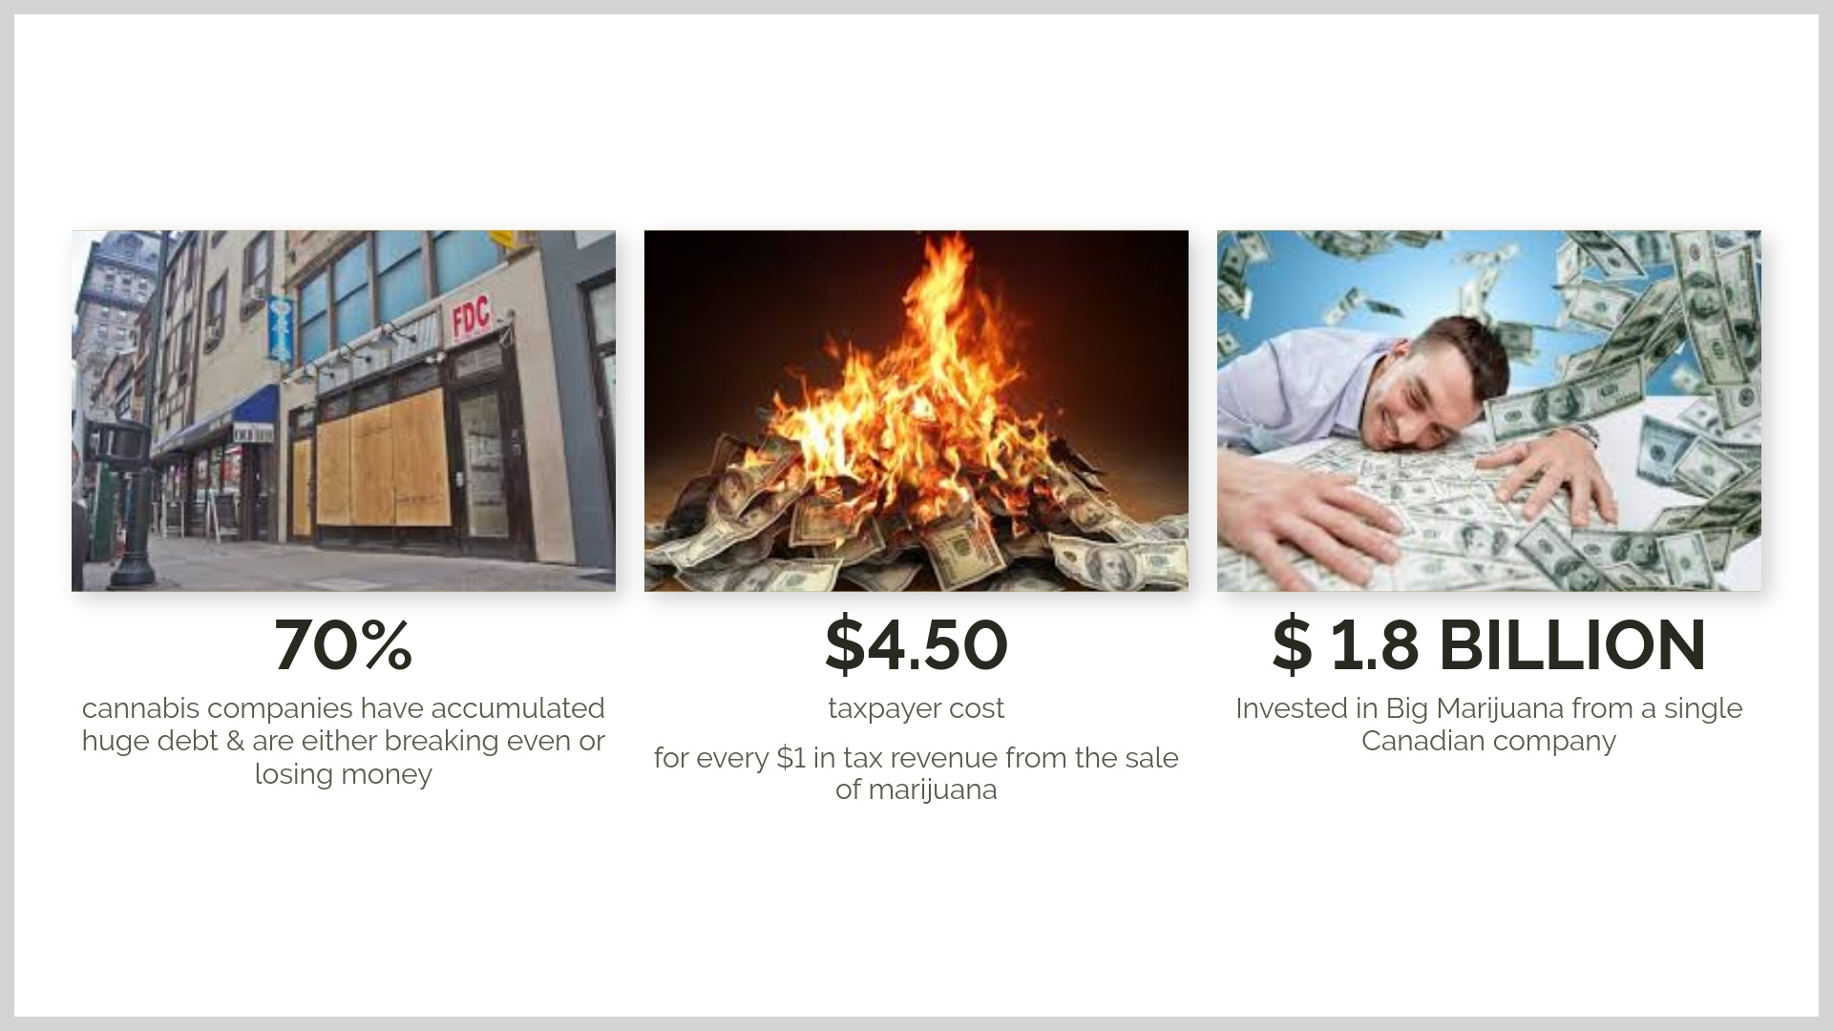
Notes:
The existing Medical Marijuana Treatment Centers founded and funded the campaign to the tune of over $50 million dollars and they created an automatic recreational license for themselves… on day one. They even ban the growing of marijuana at your own home, something that is legal in most every other state where personal use is allowed - because they insist you buy it from them. Big Marijuana learned from Big Tobacco, but this time eliminated their competition and created a monopoly.

Slide 14


Slide 15
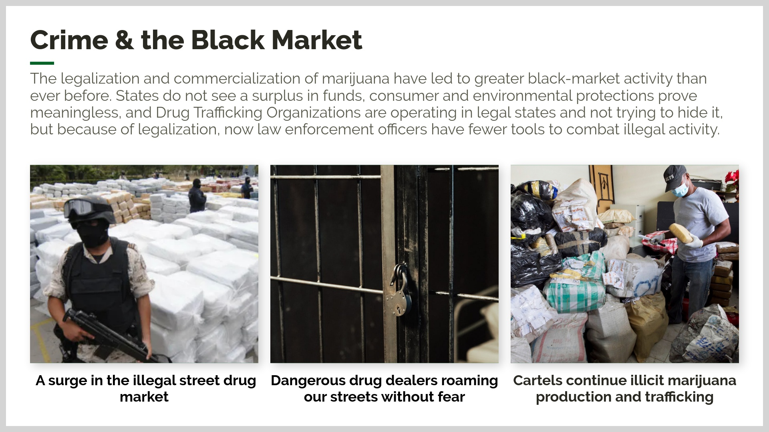
Notes:
marijuana legalization advocates have argued that legalization will reduce overall crime, but in “legal” states, marijuana crime rates have risen at a faster rate than other states across the countryall states that have legalized marijuana have failed to curtail the illicit market and drug cartels continue to exploit these black-market sales because they do not want to operate within a regulatory systemEncourages the illegal street drug market to surge. Illegal street sales will boom with legalization because legalizing, regulating, testing and taxing marijuana will increase the price, making illegal street sales much cheaper and more dangerous. In New York City an eighth of an ounce of marijuana cost $80 in legal stores, while on the street it cost only $25. The cost of legalizing spurs illegal actors and criminal cartels to grow pot and sell it without the burden of regulation and taxation - coupled with the ability to possess 3 ounces, this creates a perfect storm for an explosion in the illegal street market. (Amendment 3 proponent ads claim “billions” in taxes will be generated and boast of regulation and testing)

Slide 16
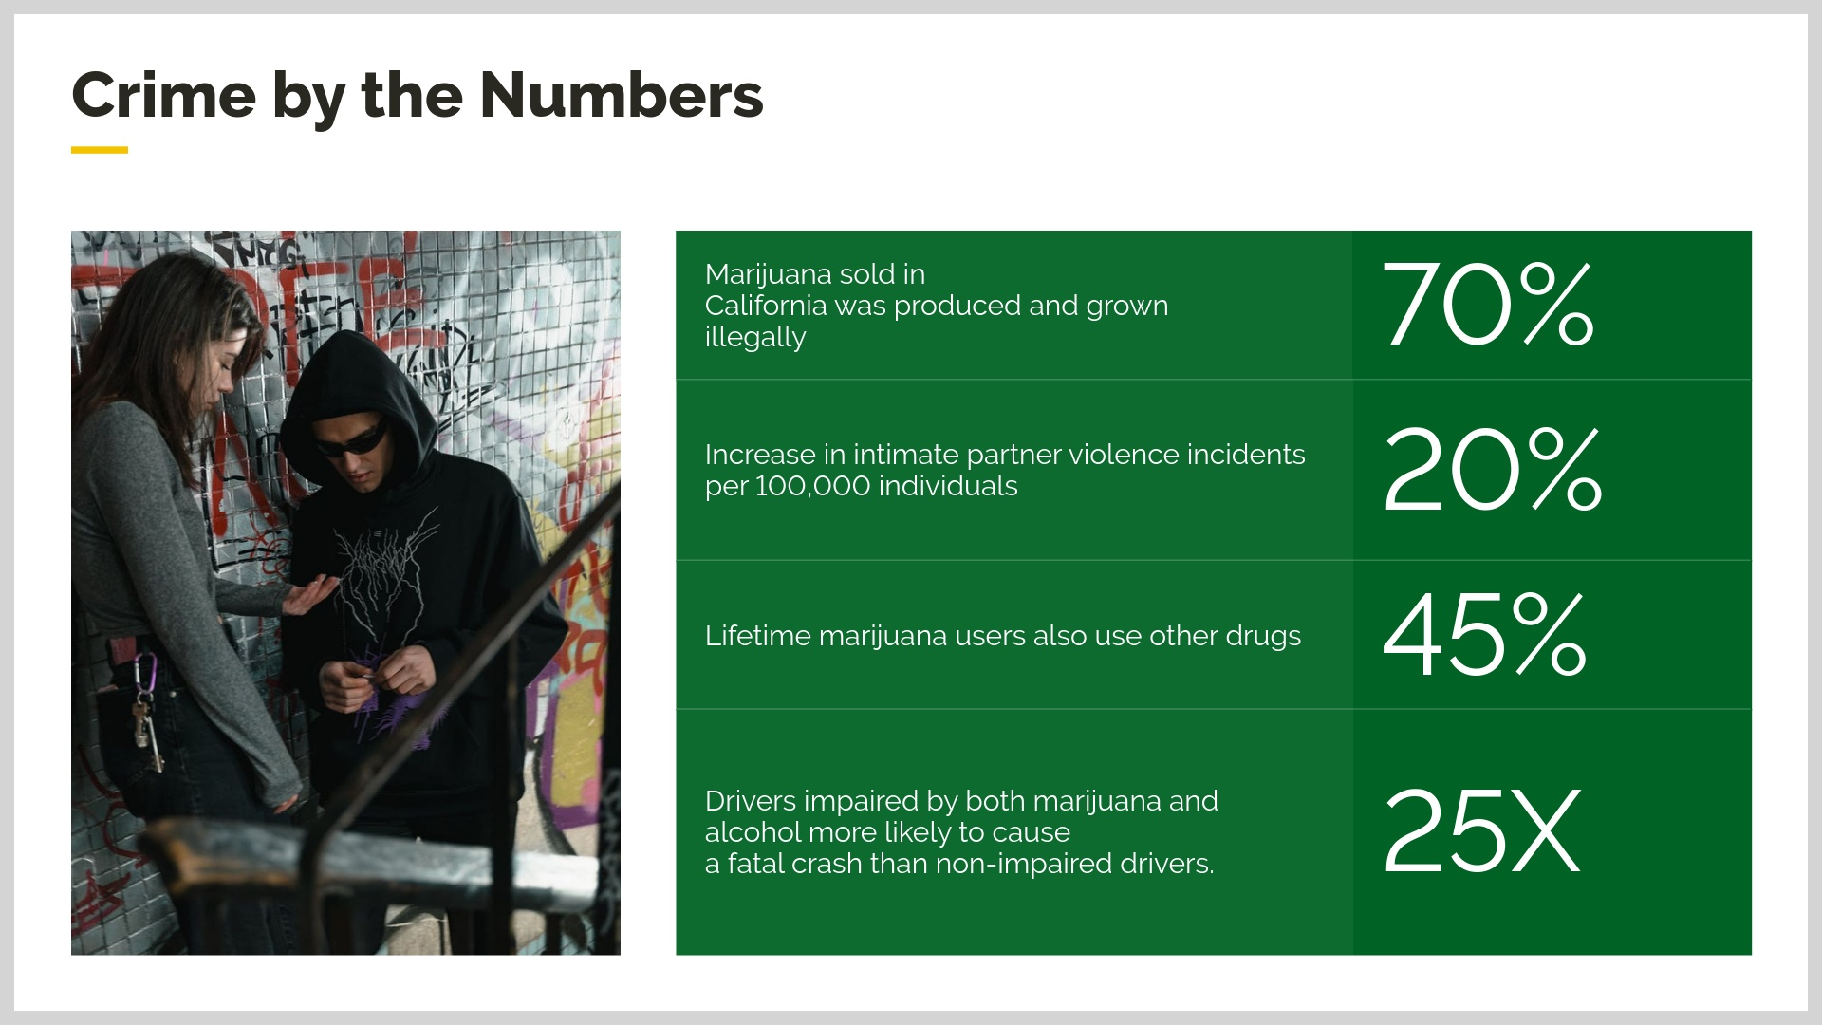

Slide 17


Slide 18
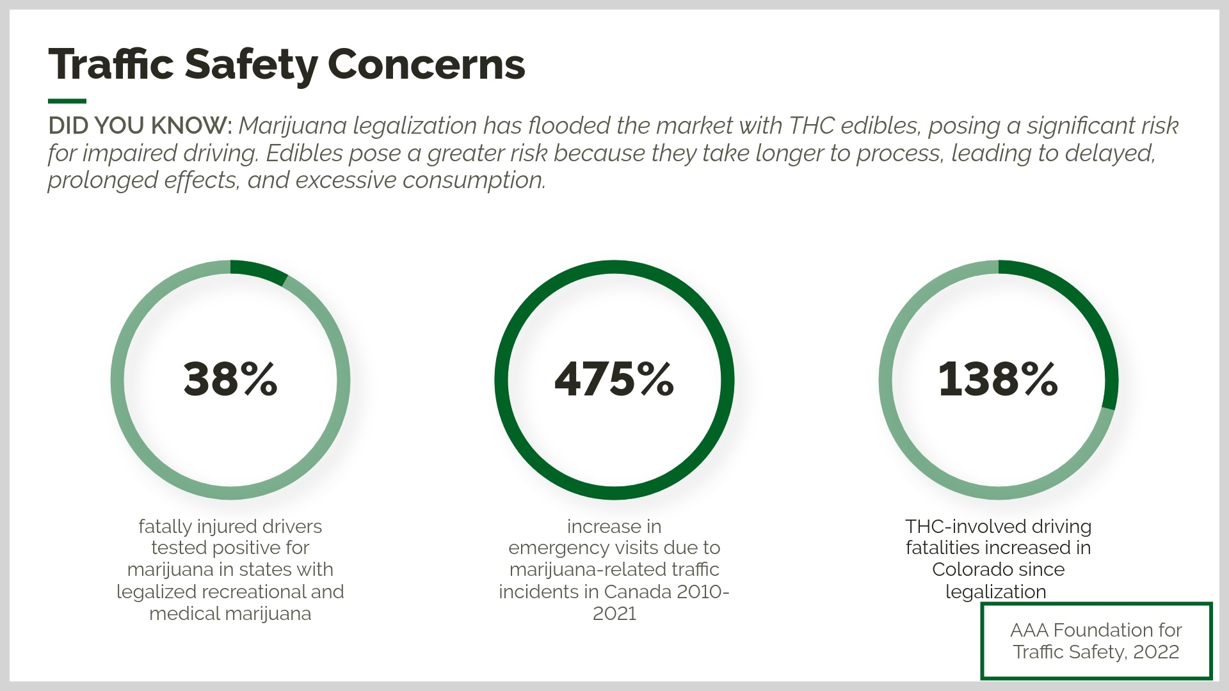
Notes:
our roadways must remain safe for our citizens to use, the legalization of marijuana runs contrary to the goal of keeping our roadways safe for our citizens. In 2020, 24.3% of drivers involved in traffic fatalities tested positive for marijuana, up from 14.8% in 2013

Slide 19
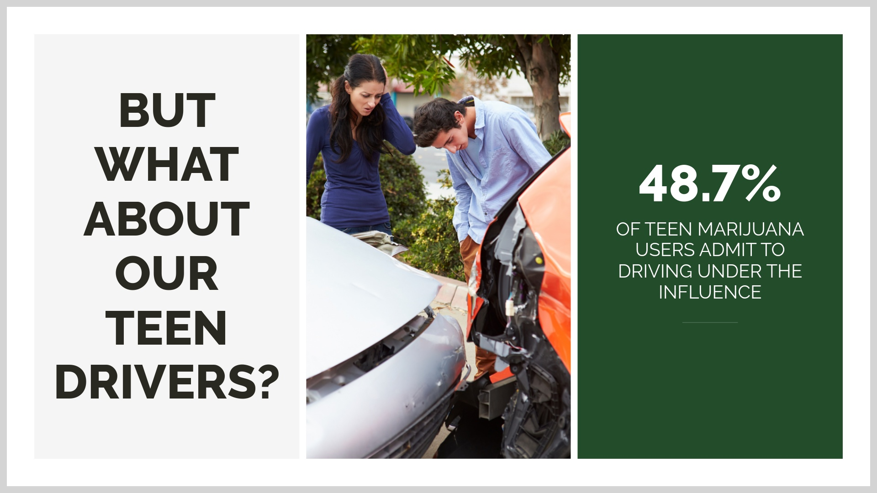

Slide 20
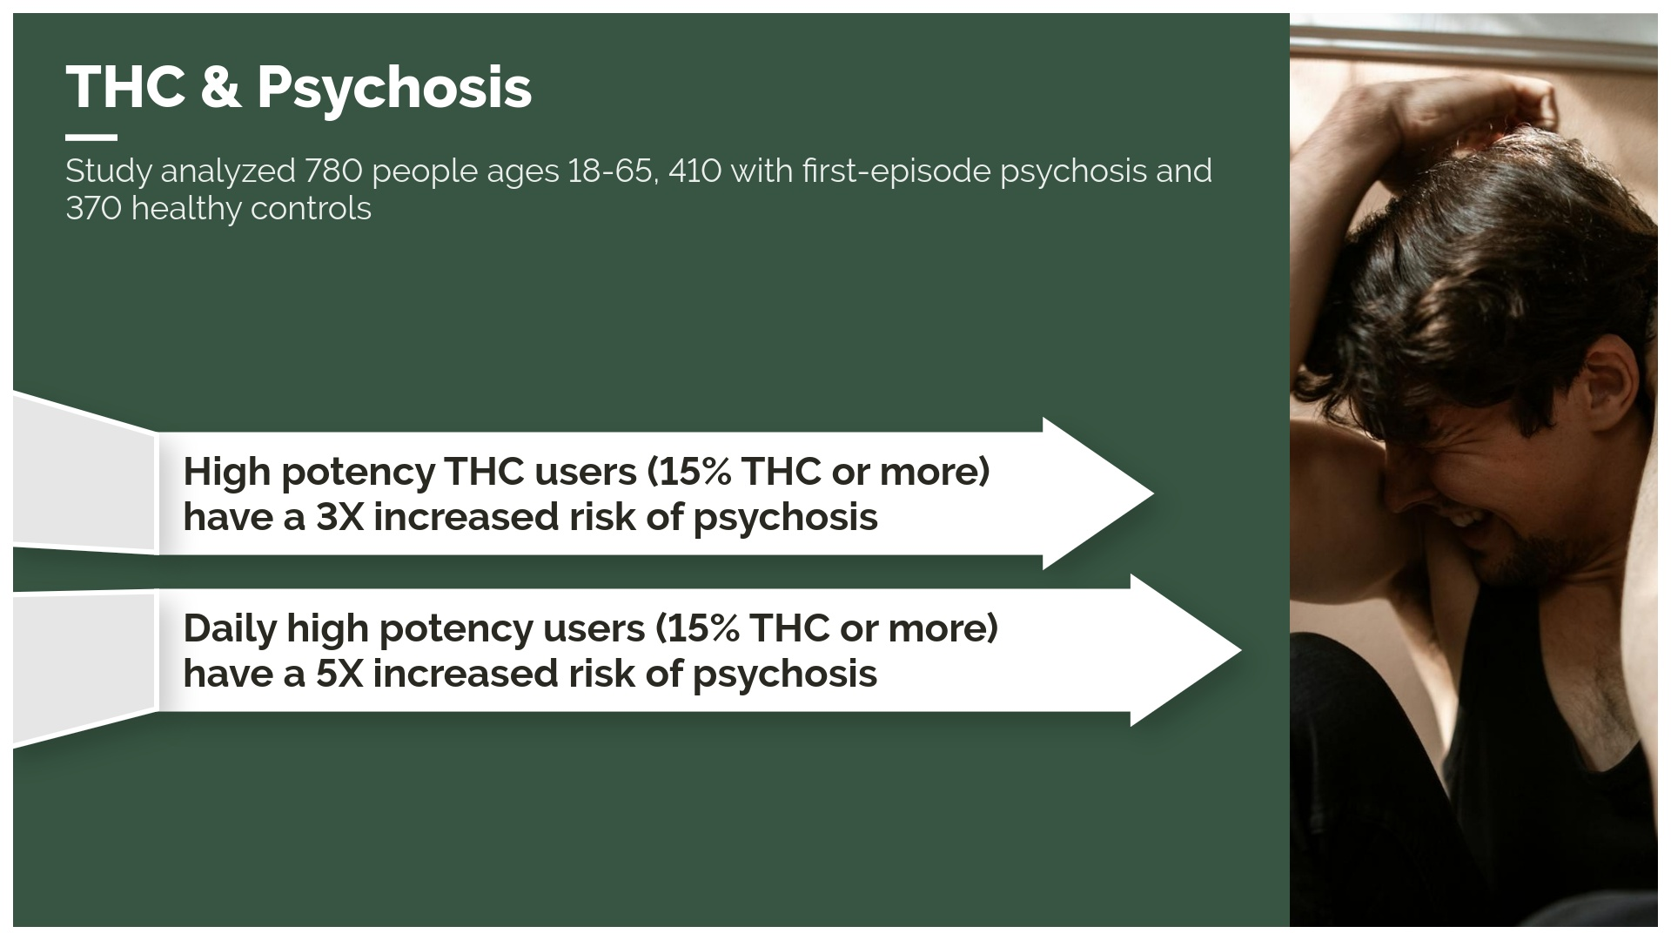
Notes:
The average potency of marijuana increasing from 3.75% THC in 1995 to 15.80% in 2018. The use of high-potency marijuana is associated with the development of anxiety, depression, psychosis, and schizophrenia, in addition to cannabis use disorderHigh potency users are: More likely to experience addiction More likely to develop general anxiety disordersMore likely to use weed at least once a weekTwice as likely to have used illicit drugs within the past 12 monthsMore than three times as likely to be tobacco smokers93% of prodcuts in Colorado are over 15% THC

Slide 21


Slide 22
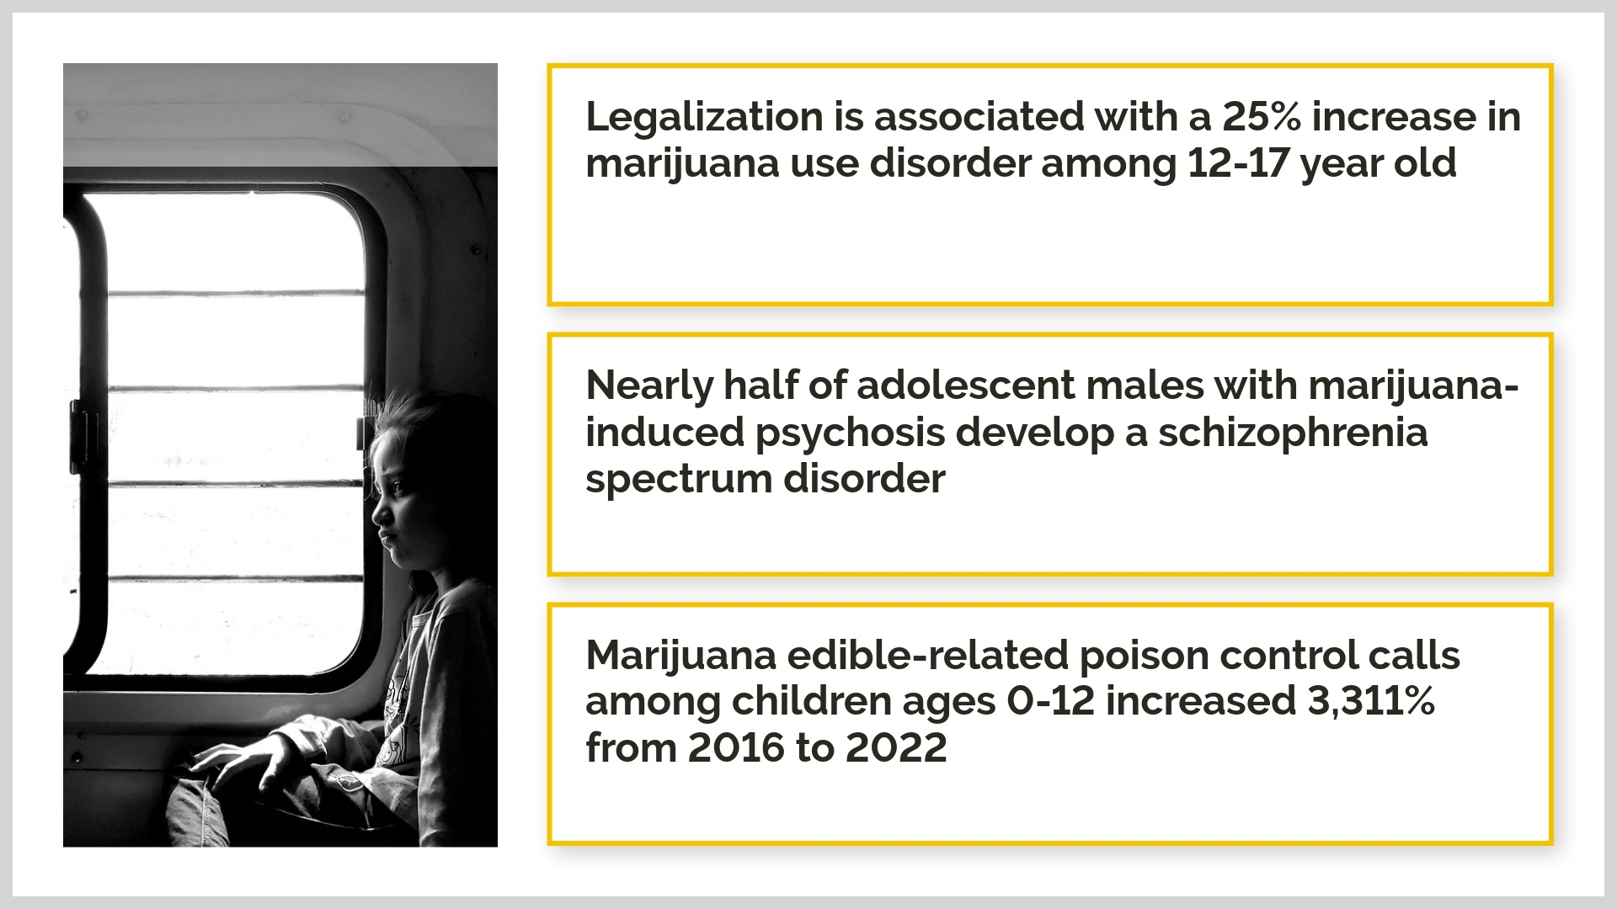
Notes:
states that have legalized marijuana have had a profound impact on rates of youth use, coinciding with decreases in risk perception; and increases in illicit behavior. 2022 analysis of a longitudinal cohort study of 21,863 individuals found that youth in states with legal recreational marijuana were more likely to use marijuana than youth in non-legal states; anda recent study found that recreational marijuana legalization was associated with a 25% increase in adolescent marijuana use disorder

Slide 23
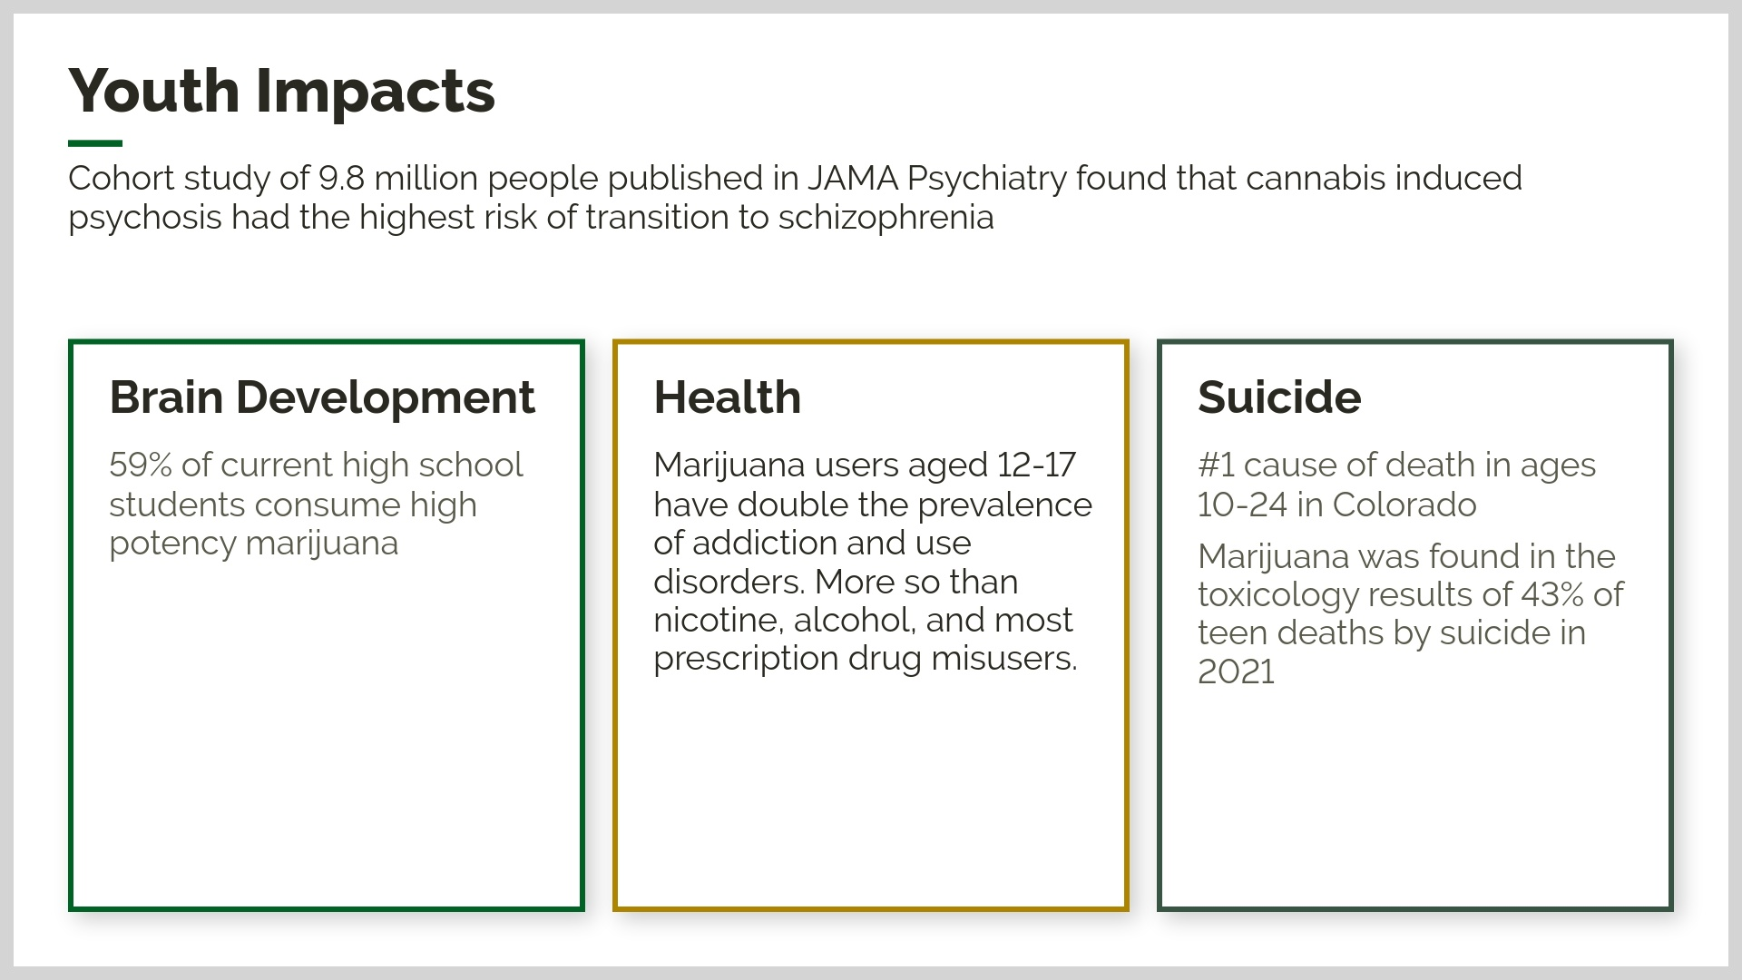
Notes:
When kids use, they have a greater chance of addiction since their brains are being primed. The adolescent brain is especially susceptible to marijuana useUse:● future high-risk use of alcohol, tobacco, and other drugs● developing suicidal thoughts or attempting suicide( just changed to SUBSTANTIALevidence based this week)● developing psychotic symptoms in adulthoodStarting use before 13:● future marijuana addictionWeekly or more frequent use:● failure to graduate from high school● not attaining a college degreeDaily or near-daily use:● developing a psychotic disorder such as schizophrenia in adulthood

Slide 24


Slide 25
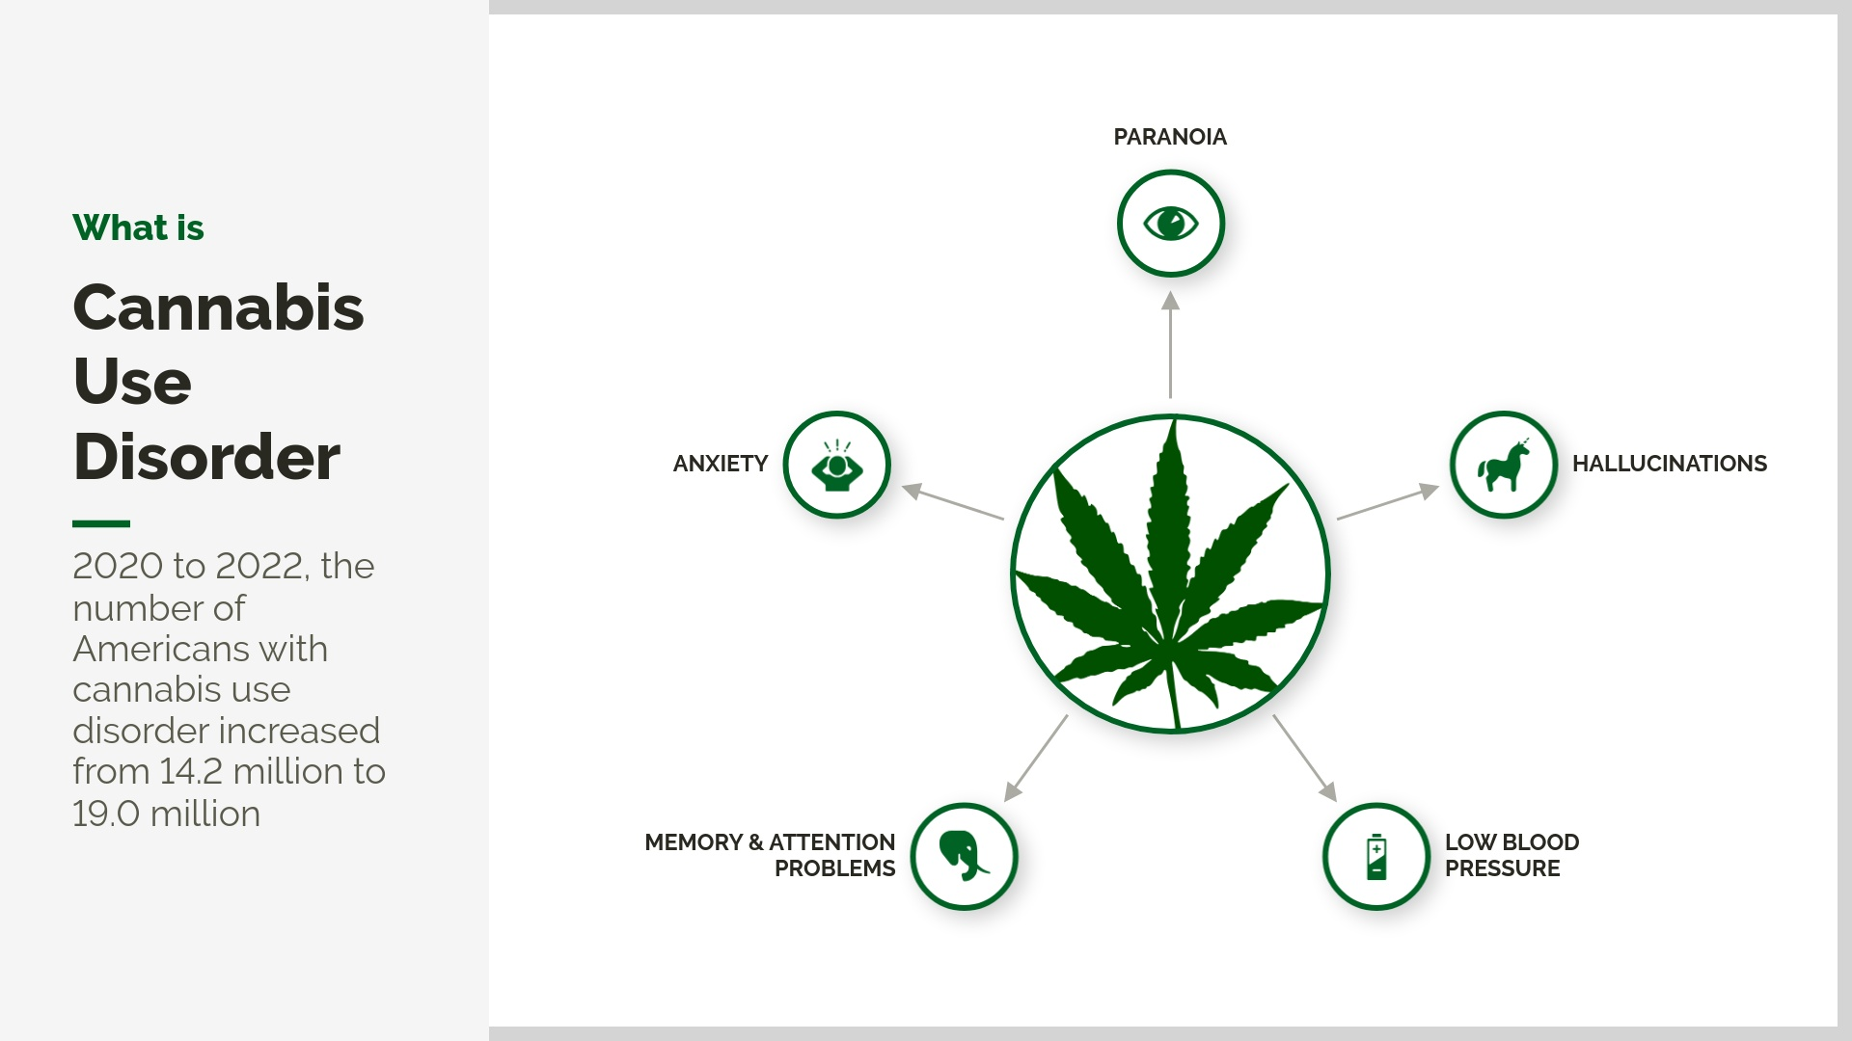

Slide 26
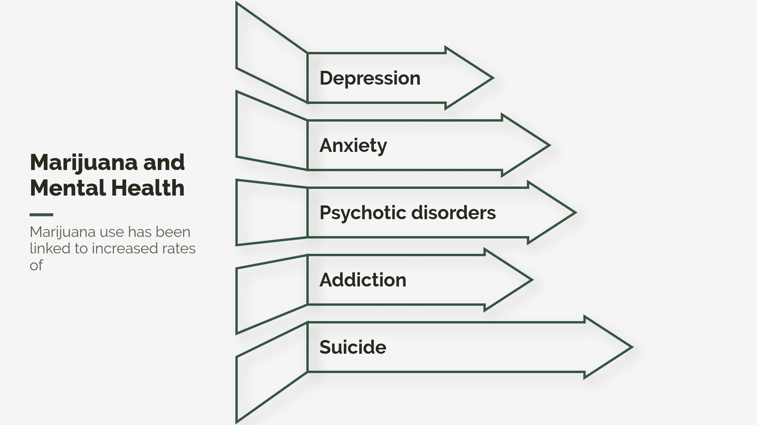
Notes:
Nearly half of adolescent males with cannabis-induced psychosis develop a schizophrenia spectrum disorder within 3 years.

Slide 27
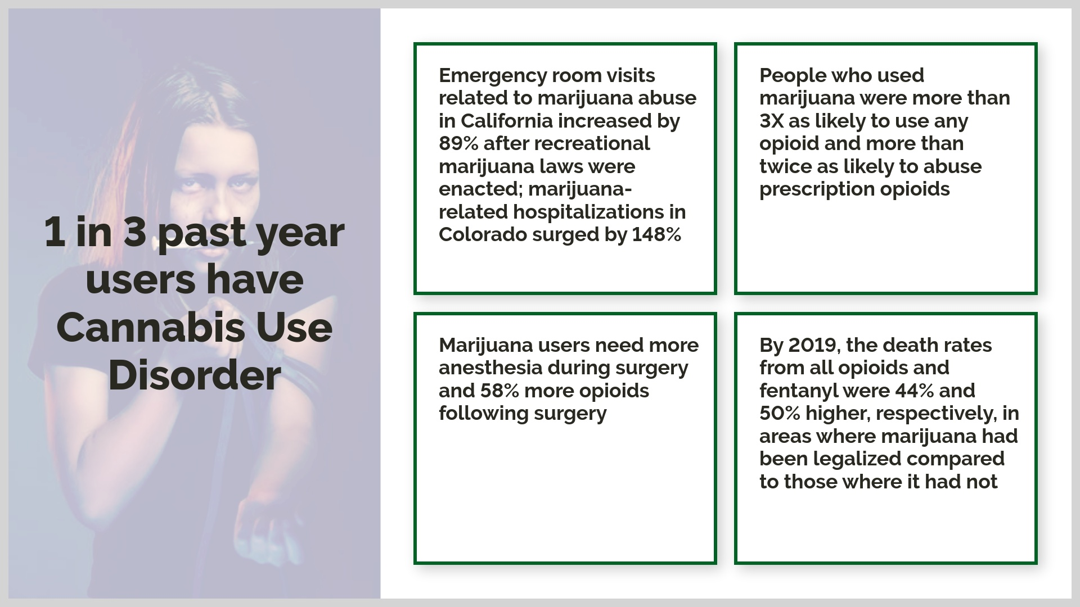
Notes:
Although several states legalized medical marijuana as an "alternative" to opioids, medical marijuana sold through dispensaries is associated with higher opioid mortality. medical marijuana is associated with 23% more opioid deaths..Any use of marijuana linked to higher risk of heart attack (25% increase) and stroke (42 %increase)Risk increases as frequency of marijuana use increasesmarijuana legalization was associated with a 10% increase in workplace injuries among individuals aged 20 to 34

Slide 28
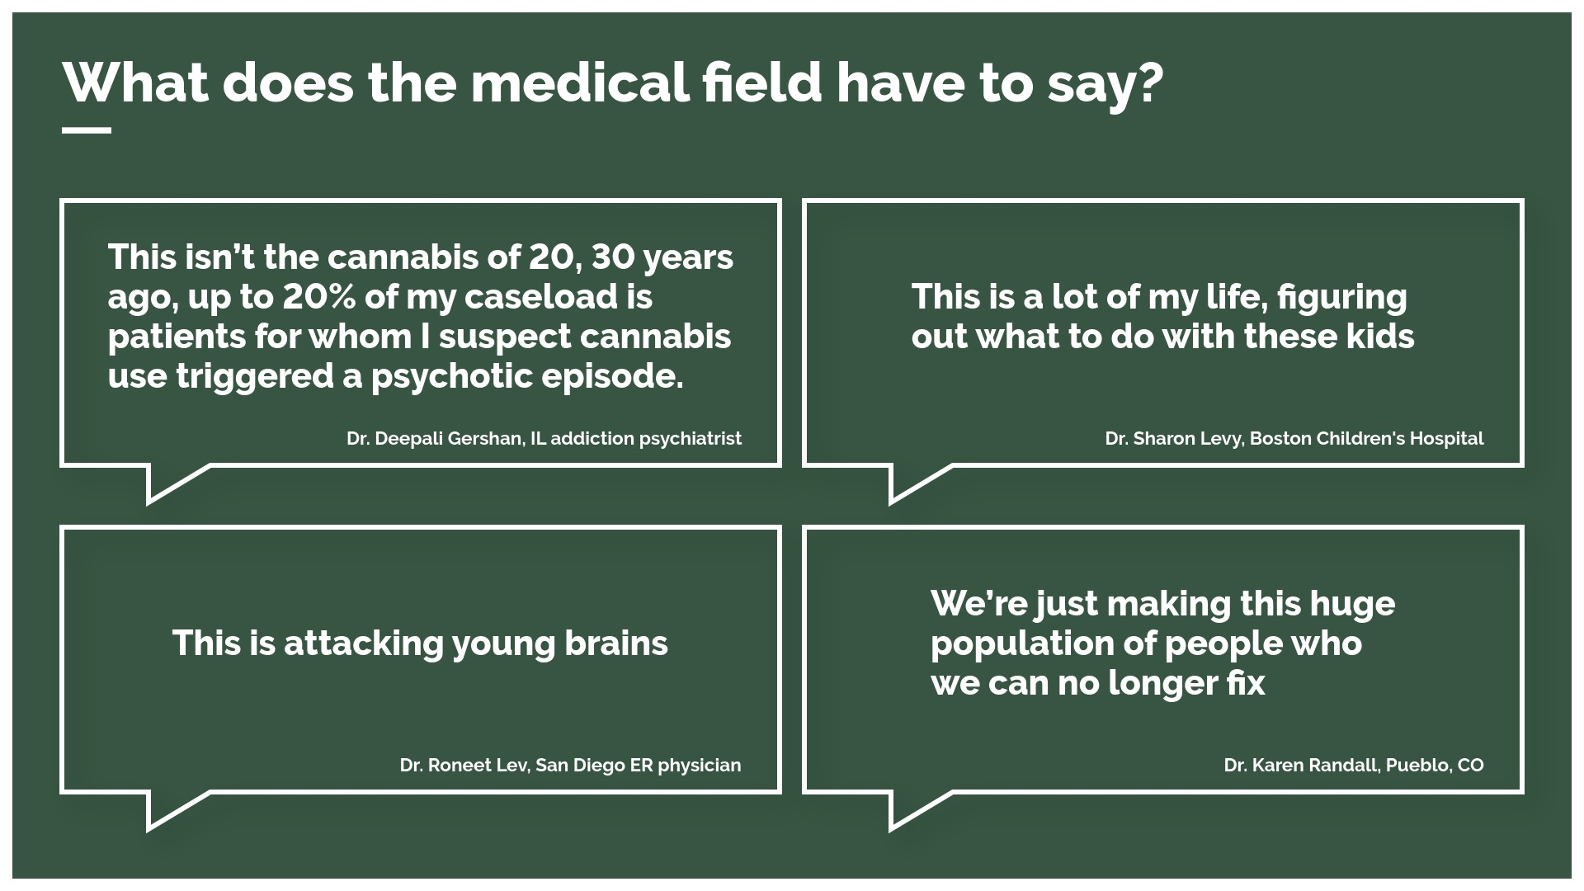

Slide 29
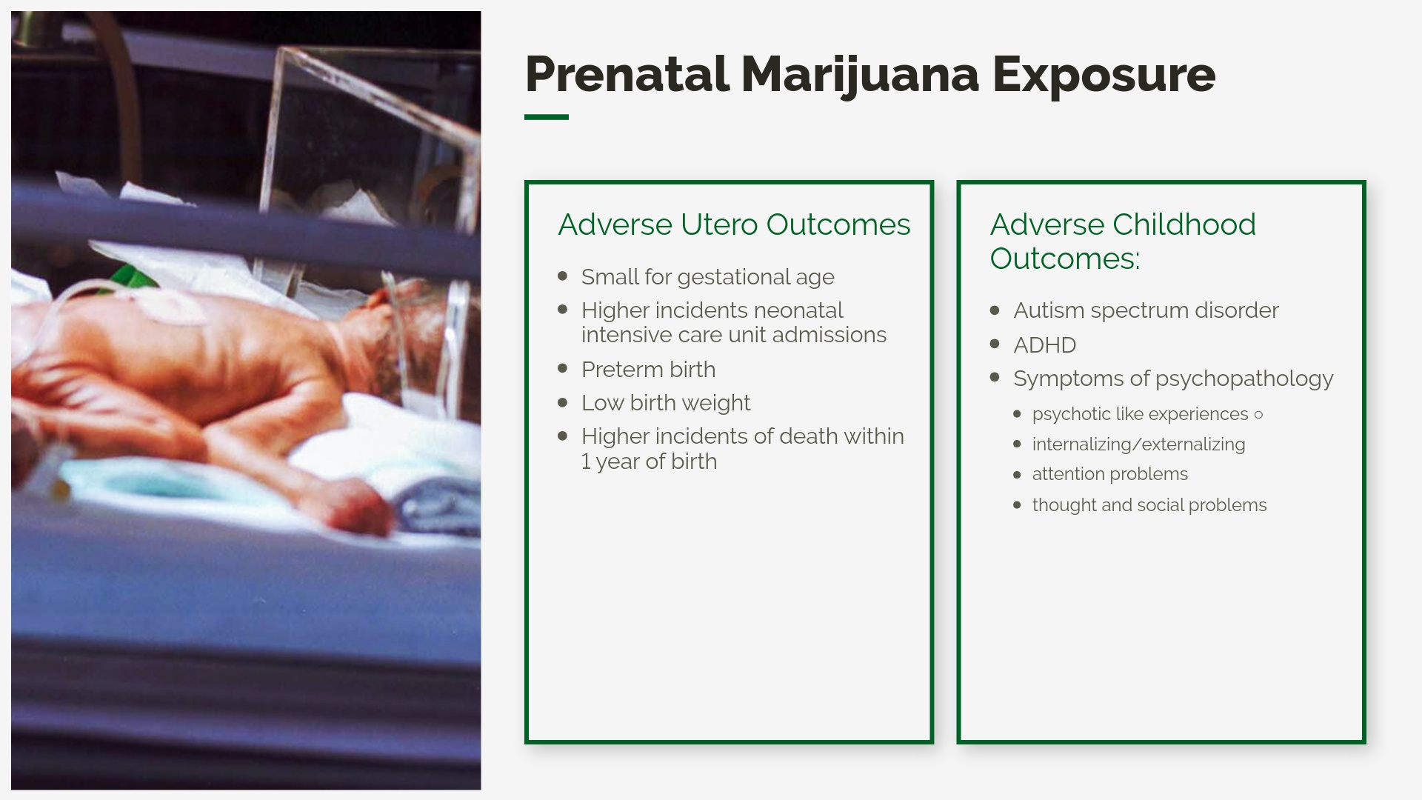

Slide 30
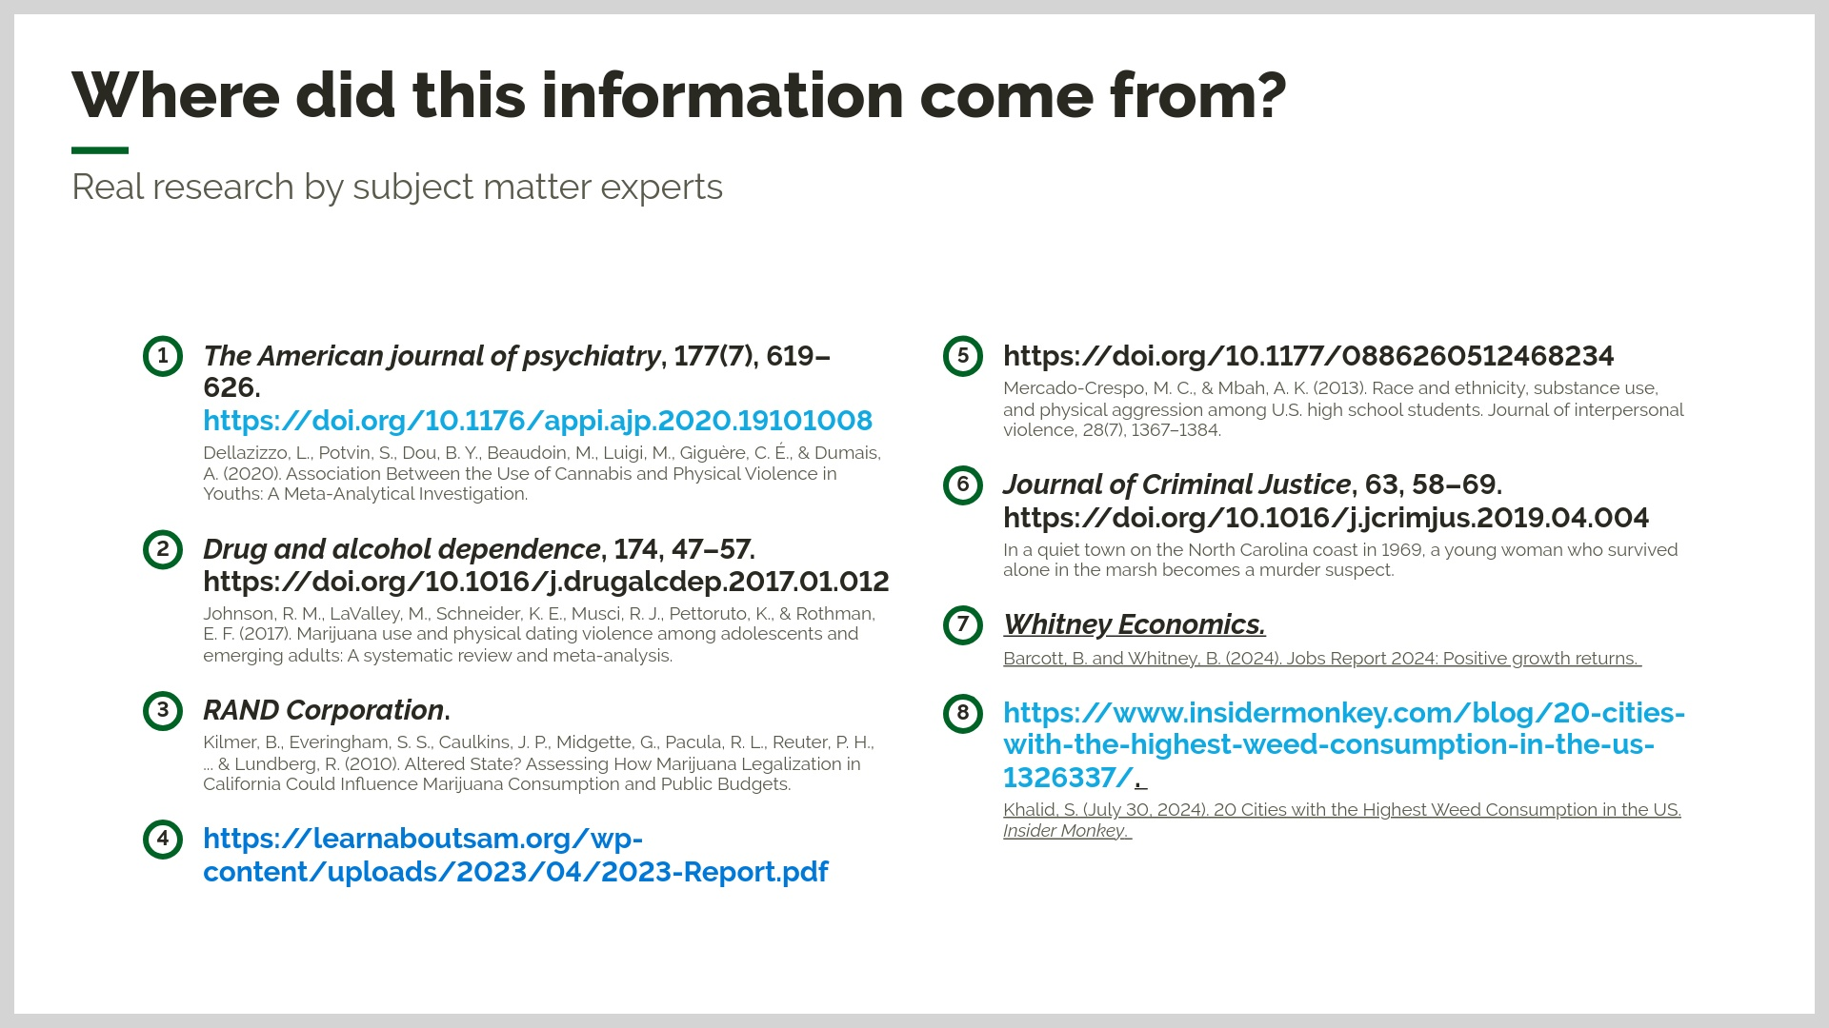

Slide 31
